Slide 1



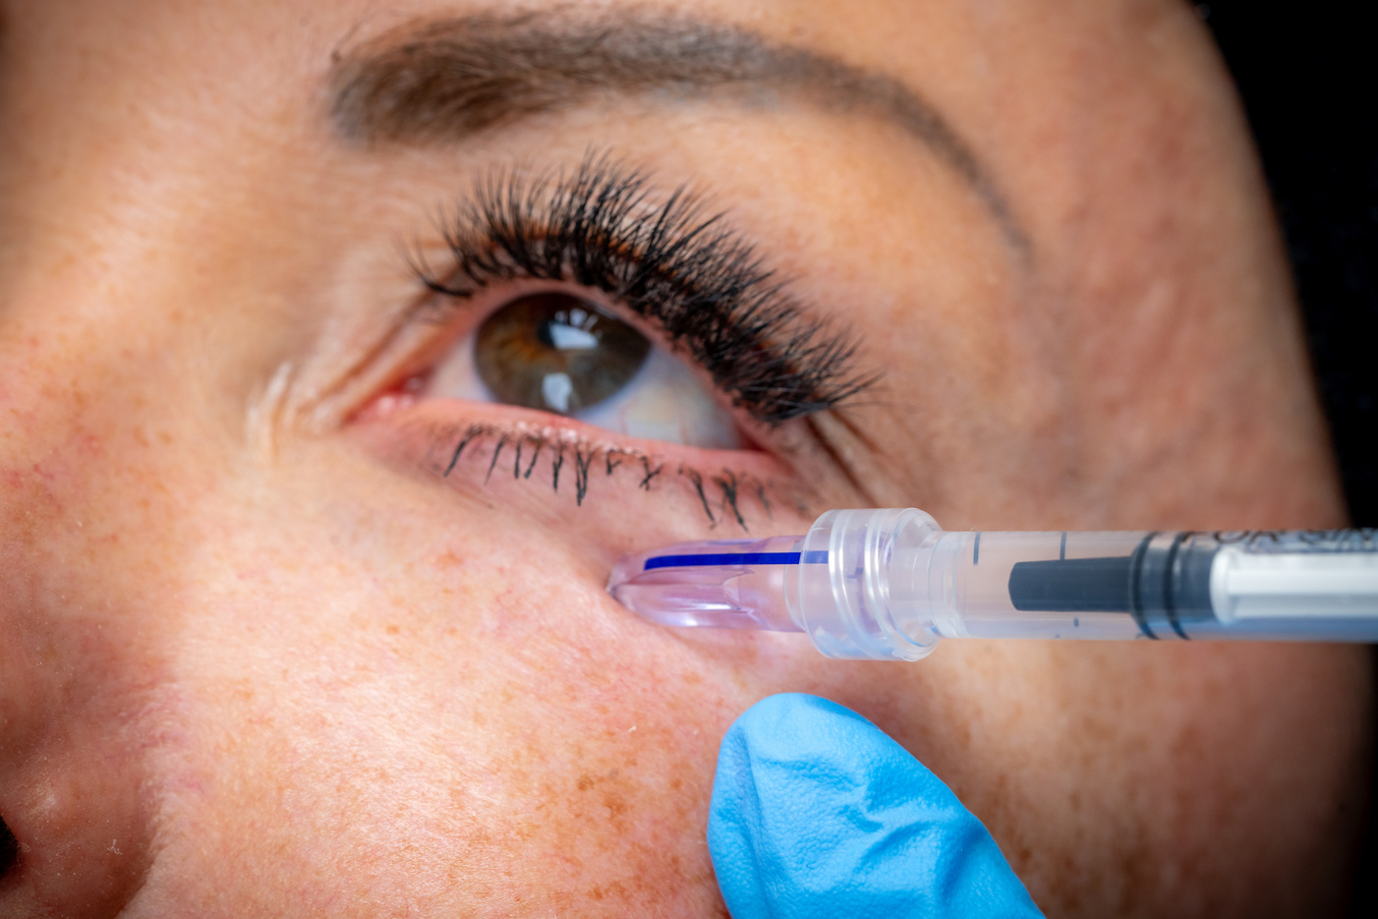


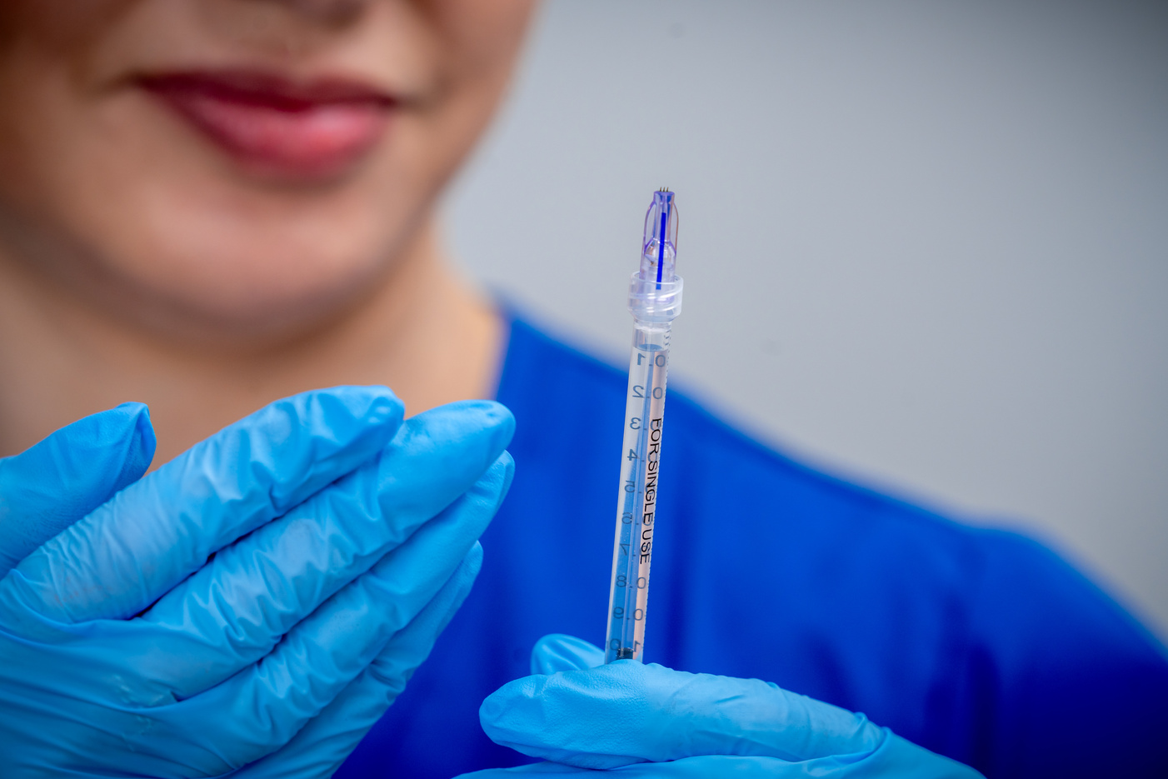


Comfort They Feel.
Precision You Trust.

Slide 2
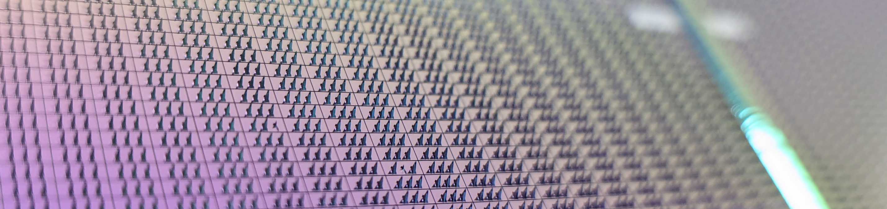
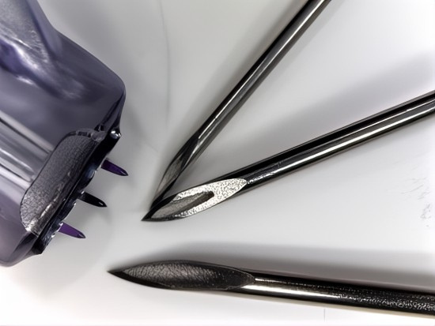
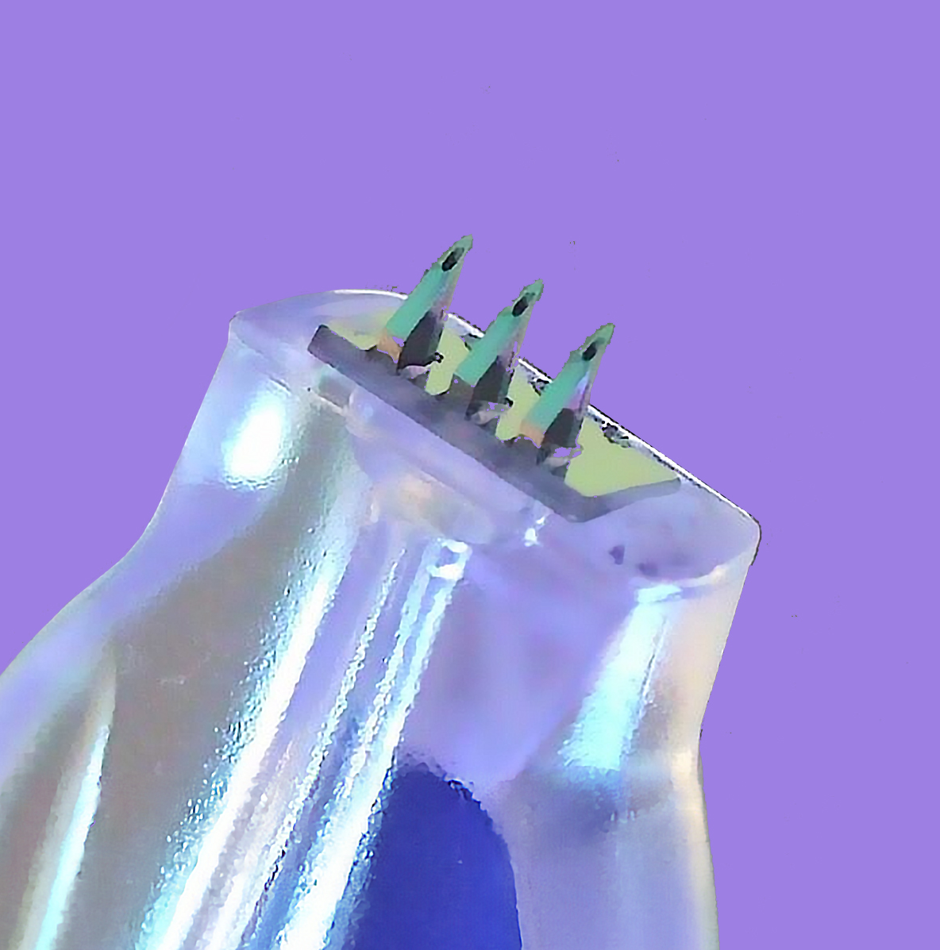

Precision is the Core Value of Our Patented Technology
The Technology
Made from 3 pure silicon-crystal pyramids
Manufactured using semiconductor chip technology (MEMS - Micro-Electro-Mechanical Systems)
The Result
Ultra-precise for accurate dermal delivery
Sharp, potent and blunt resistant

Slide 3
Why
Why
for Aesthetics Treatments

Slide 4
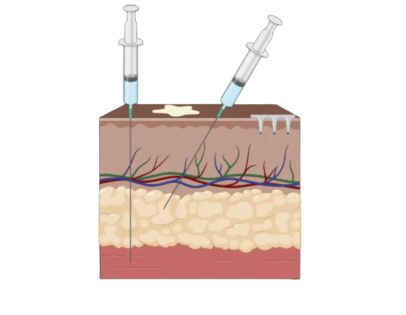
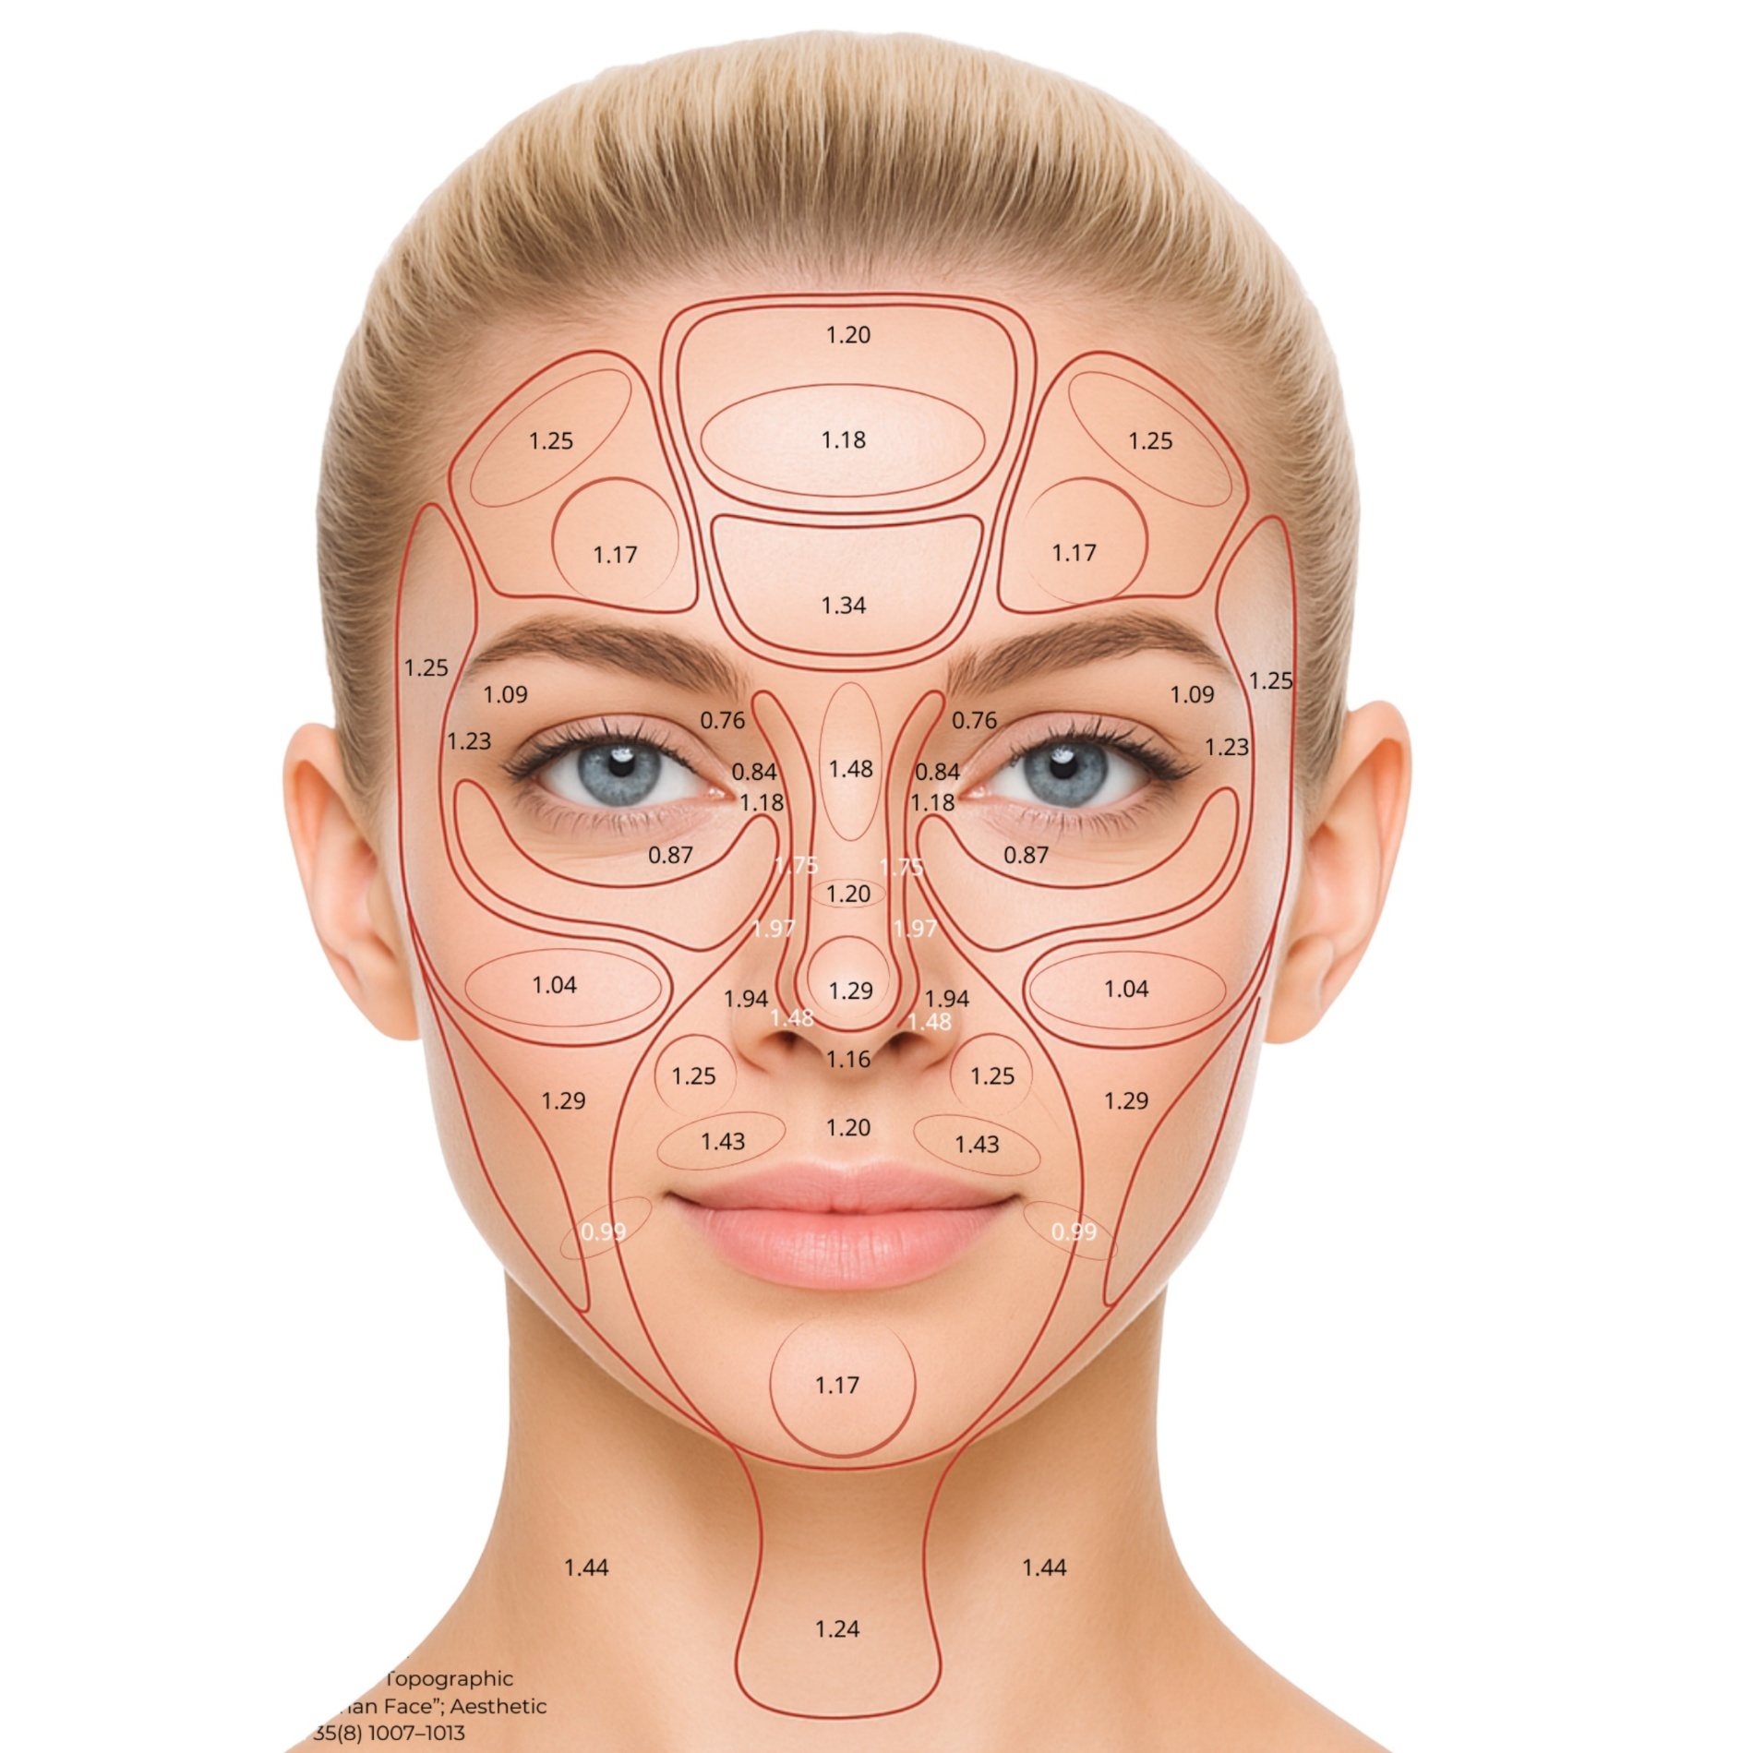
The Problem: ~ 70% of intradermal injections are inaccurately administered, reaching the hypodermis¹
MicronJetTM
Controlled depth for reliable
Dermal targeting
The Solution: True Dermal Delivery, by Design
Epidermis
Dermis
Subcutaneous
Muscle
The average dermis thickness
in the face is 1.1mm ²
The Result:
Virtually Pain-Free
Virtually Bruise-Free
Micheels P, Goodman L. Injection depth in intradermal therapy: Update and correction of published data. J Drugs Dermatol. 2018;17(1):88–96.
Chopra K, Calva D, Sosin M, Tadisina KK, Banda A, De La Cruz C, et al. A comprehensive examination of topographic thickness of skin in the human face. Aesthetic Surgery Journal. 2015;35(8):1007–1013.

Slide 5
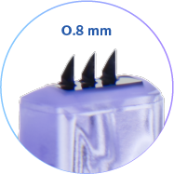
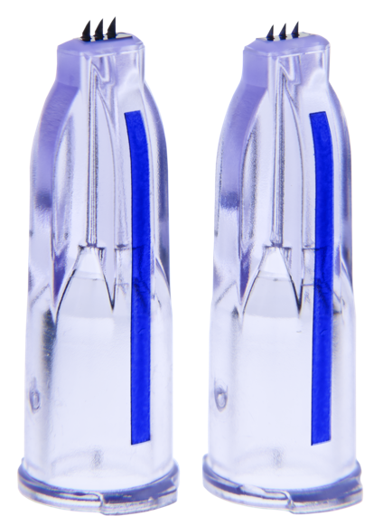
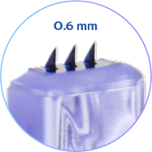
One Design. Two Depths. Different Flow Rates.
Why
MicronJetTM 800µm
MicronJetTM 600µm
0.8 mm long
Optimized for medium-to-high viscosity formulations
Flow rate equivalent to 27-gauge needle
Highly suitable for aesthetic treatments in slightly thicker-skinned areas like the scalp, jawline and cheeks
0.6 mm long
Optimized for low viscosity formulations
Flow equivalent to 30-gauge needle
Highly suitable for aesthetic treatments in delicate thinner-skinned areas like the periorbital, perioral, neck and décolleté

Slide 6
Why
Additional Benefits

Slide 7
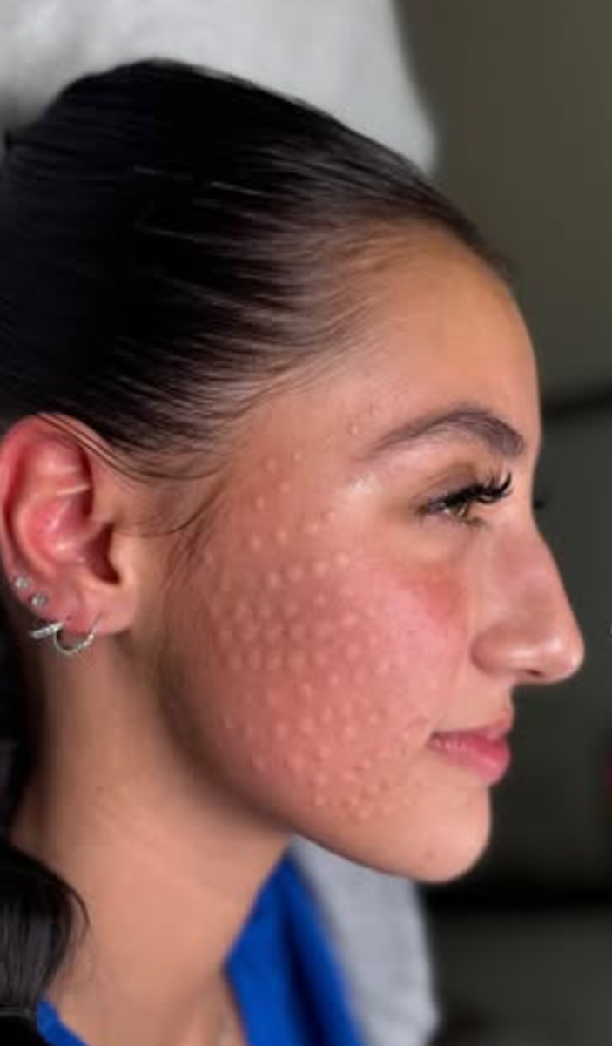
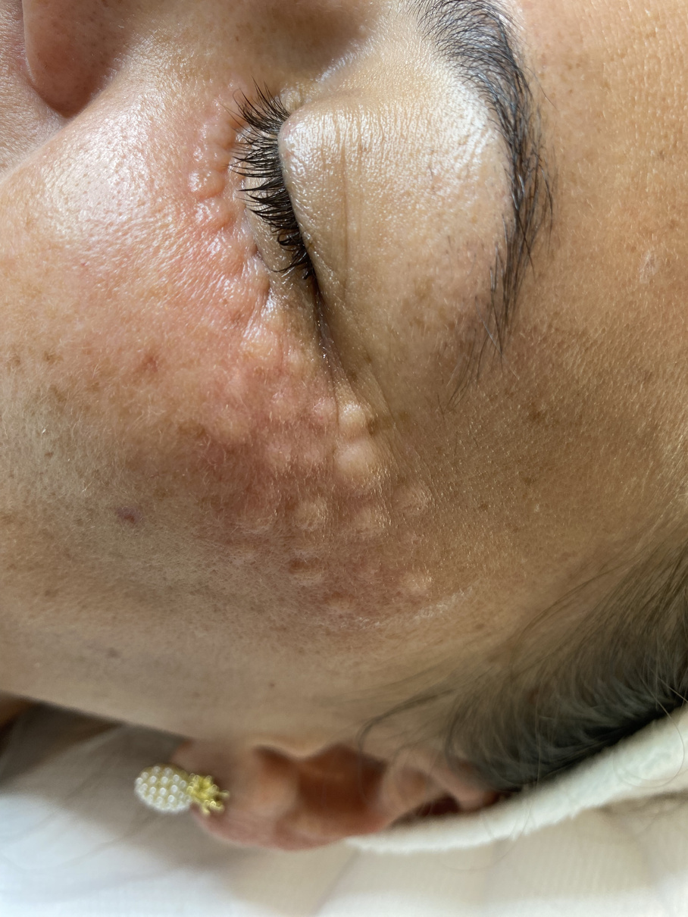
Immediate Confirmation on Intradermal Placement
Bleb appearance = accurate dermal placement
Why

Slide 8
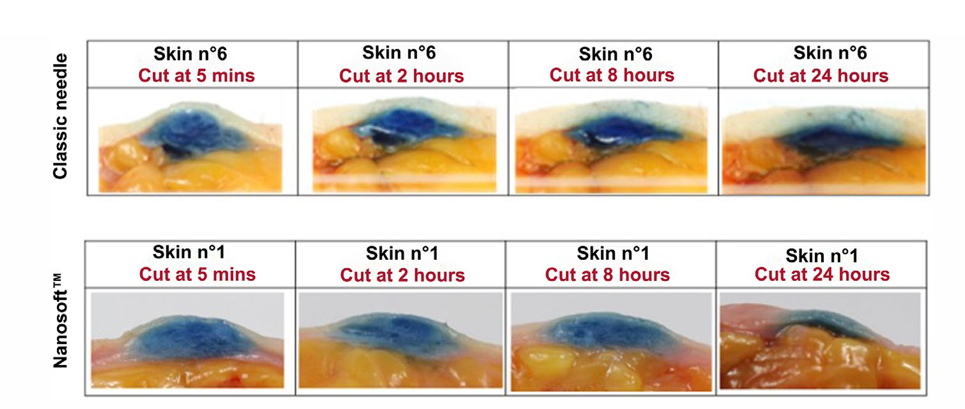
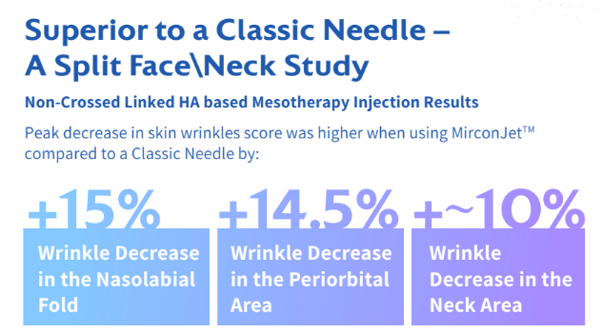
Precision & Efficacy That Delivers Proven Superior Results
Migration of the active substance into the fatty layer
Superior results
to MicronJetTM vs.
a classic Needle in split face study¹
High efficacy in dermal placement. Not Deeper
1. Bocà A, Fanian F, Smirnov R, Redaelli A, Gorogourchun R, Issa H, et al. Evaluation of the performance and safety of a new micro-needle technology in comparison with the classic needle on the antiaging effects of a biorevitalizing solution: A randomized split-face/neck study. J Cosmet Dermatol. 2015;14(3):210–215.

Slide 9

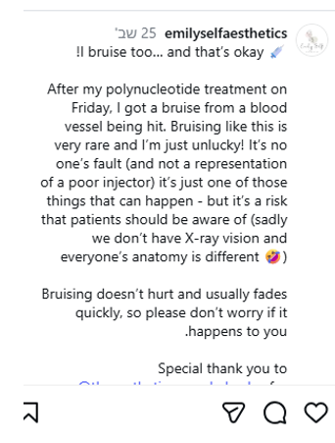
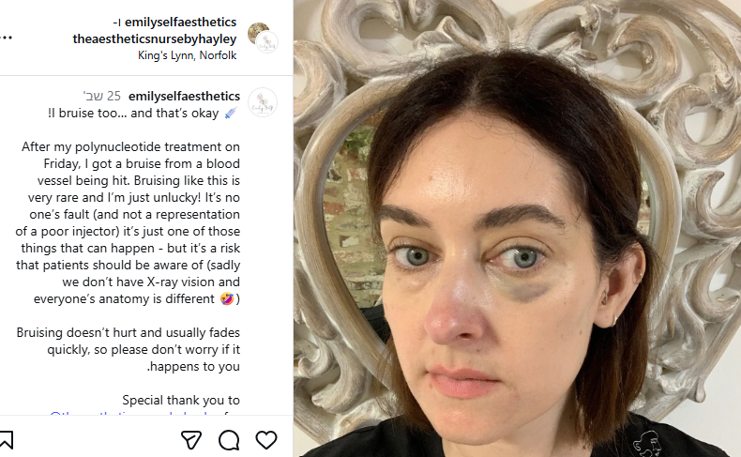
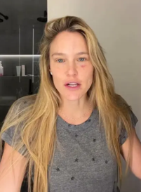
Minimal Downtime Impact Patients Retention
Precise intradermal delivery minimizes trauma, bruising and downtime
Dr. Shino Bay Aguilera, Dermatologist
Why
“If you bruise them, you lose them, I don’t get any bruising with MicronJetTM”
Bruising post injection with stainless steel needle in the periorbital area

Slide 10
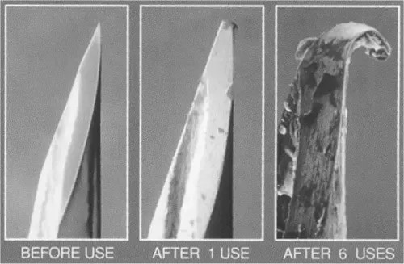
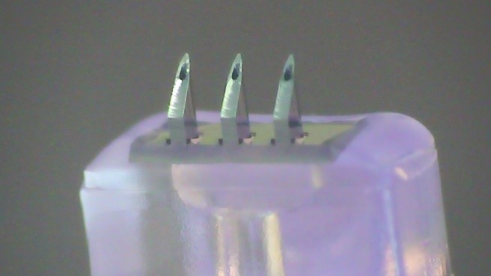
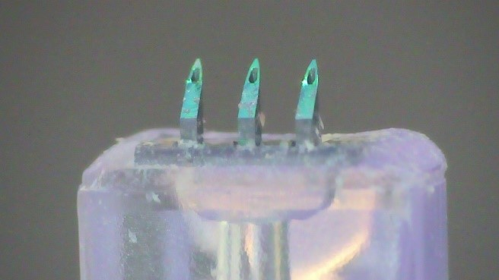
One Device. One Treatment. Full Area
Stainless Steel Needle
Before Treatment
Blunting After 6 Injections
Blunting and Bending After Multiple Injections
MJ800 Before Treatment
Fully Intact MJ800 After 50 Insertions
Blunt Resistance
The impact of blunting:
Increased pain, tissue damage, unpredictable material absorption
Data on file (Laboratory test for evaluating resistance to blunting)

Slide 11

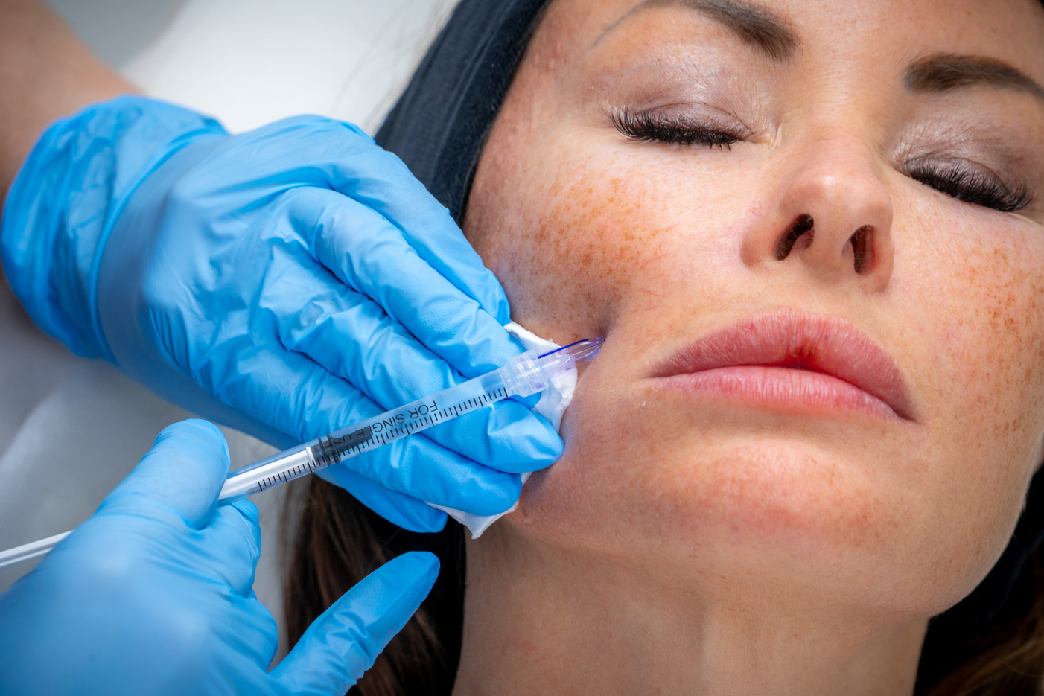
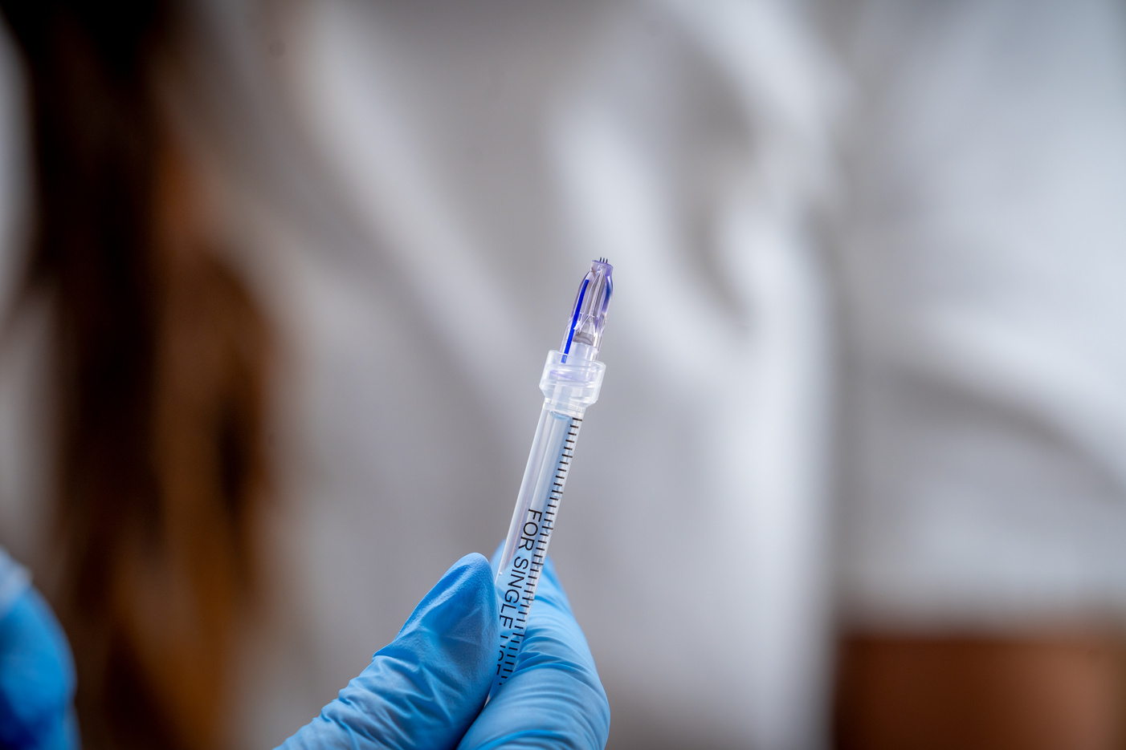
Aesthetic and Dermatologic Applications
Substances
Aesthetics & Dermatology
Skin rejuvenation
Mesotherapy
Lips hydration
Scar revision
Strech marks
Axillary hyperhidrosis
Rosacea
Hyperpigmentation
Hair restoration
Hair restoration (MJ800)
Eyebrow restoration
Local anesthesia
Before invasive procedures (biopsy, abscess drainage, cannula insertion)
Before treatment with EBD
Aesthetics & Dermatology
Skin boosters (non-cross-linked HA)
Mesotherapy cocktails
PRP
IPRF
PN & PDRN
Corticosteroids
5FU
Botulinum Toxin (Microtoxin & hyperhidrosis)
Hair restoration
PRP
IPRF
Hair restoration formulas
Dutasteride
Minoxidil
Local anesthesia
Lidocaine
* Local Regulatory Approval Dependent

Slide 12
Where Comfort Meets Clinical Precision
Accurate depth control
for dermal
delivery
Precision
Controlled dermal delivery reduces tissue trauma and pain
Reliable clinical outcomes in target layer
Virtually Pain-Free
Efficacy
Maximizes product use, minimizes material waste (not going deeper)
Virtually Bruise-Free
Shallow delivery avoids deeper blood vessels
Efficiency
Redefining Intradermal Delivery
High Safety Profile
Minimal Downtime
Reduces risk of serious complications linked to deep placement
Quick recovery, patients resume routine immediately
Blunt Resistance
One device, one treatment - No dulling during treatment

Slide 13

Better Patient Experience = Practice Growth
Comfortable, low-trauma treatments improve patient satisfaction, encouraging repeat visits, stronger loyalty, and positive referrals that support long-term practice growth.

Slide 14
Clinical Evidence:
Where Precision Meets Proof
Why

Slide 15
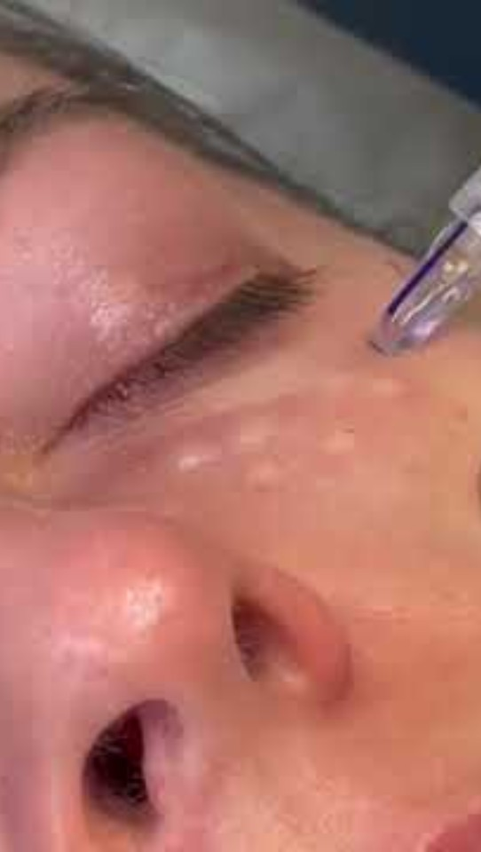
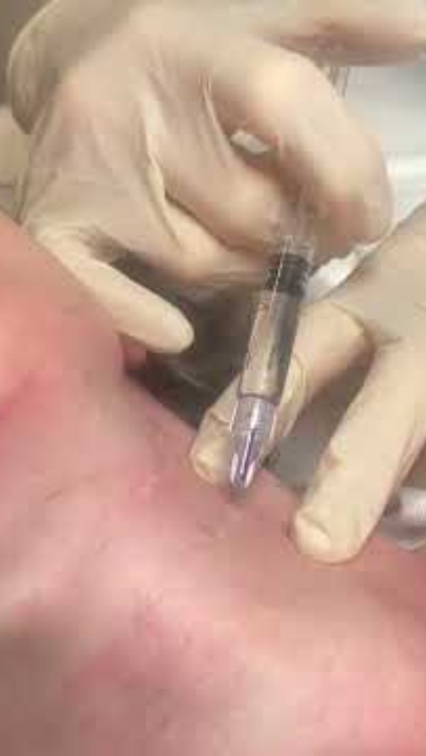
Procedures
Eyes , Decollete / Neck (click the picture to watch the video)
Procedures performed by Dr. Elisabeth Dancey, Cosmetics Clinician
Substance: Skin booster, non-cross-linked HA

Slide 16
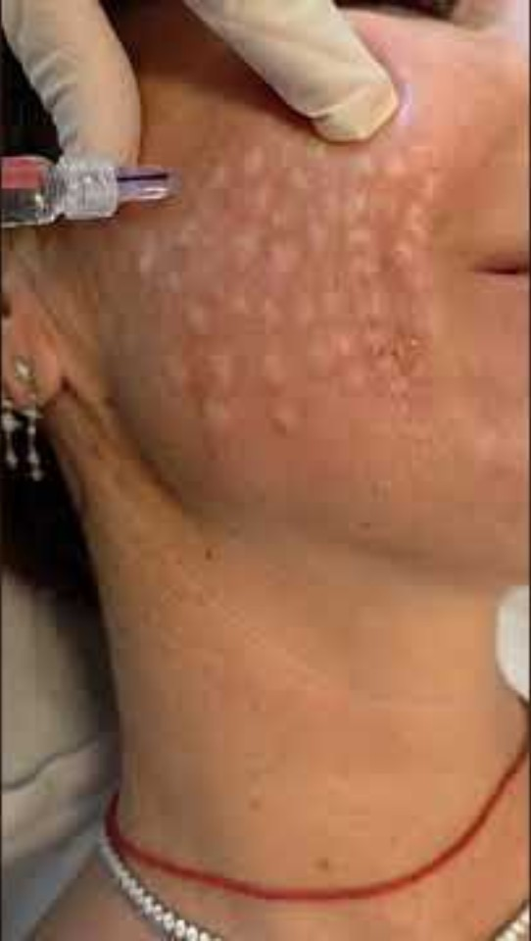
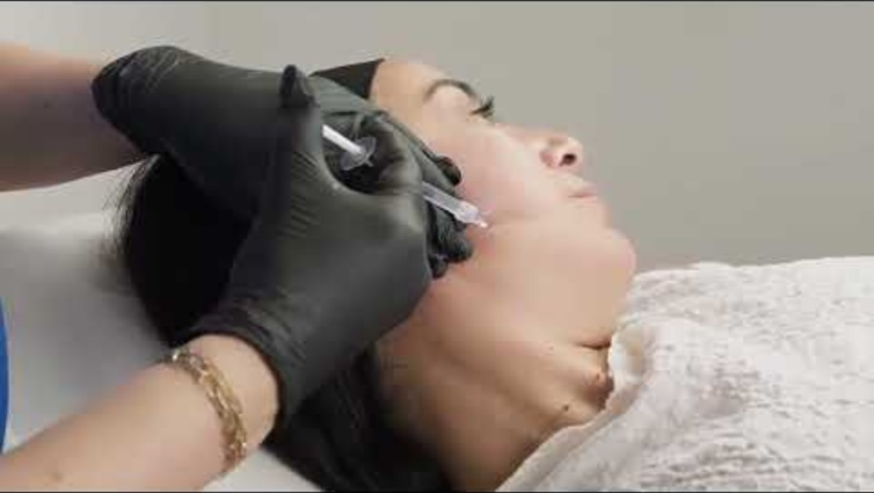
Procedures
Full Face (Click the picture to watch the video)
Procedure performed by Dr. Tahel Altman, Aesthetics Clinician
Substances: Skin booster, non-cross-linked HA

Slide 17
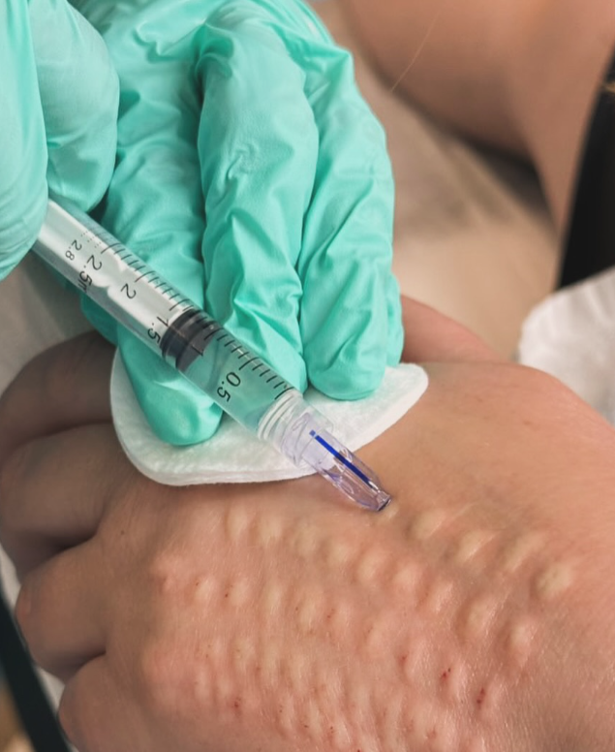
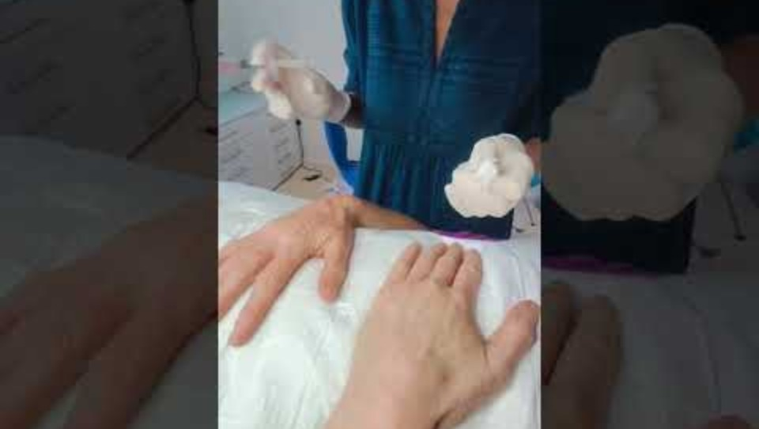
Procedures
Hands (dorsum) Rejuvenation
(Click the picture to watch the video)
Procedures performed by Dr. Elisabeth Dancey, Cosmetics Clinician
Substance: Skin booster with calcium

Slide 18
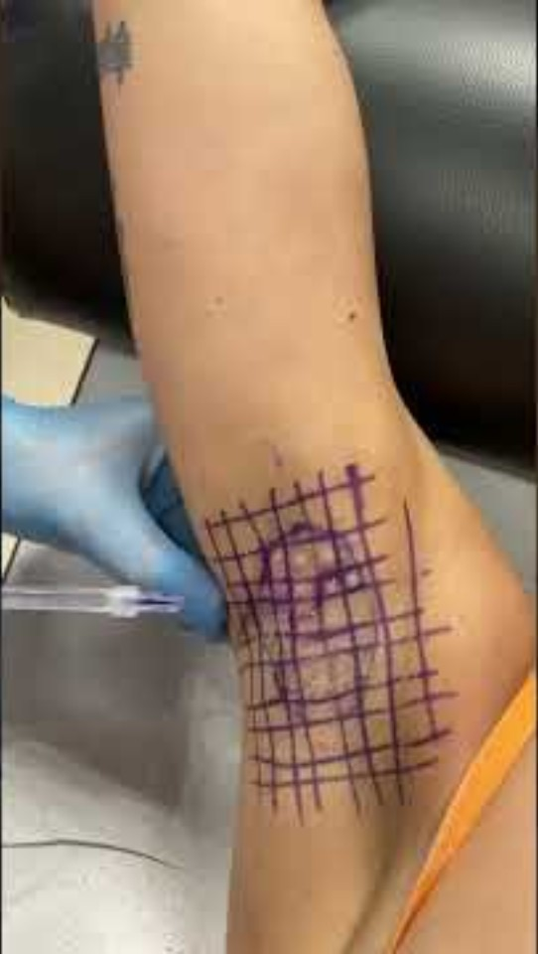
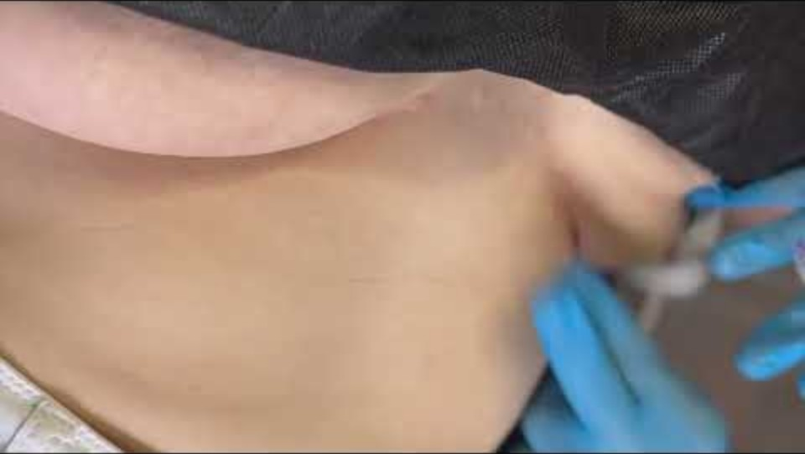
Procedures
Axillary Hyperhidrosis & Under the Chest Hyperhidrosis
(Click the picture to watch the video)
Procedure performed by Dr. Alberto Diaspro, Maxillofacial Surgeon
Procedure performed by Dr. Riekie Smit, Aesthetic Clinician

Slide 19
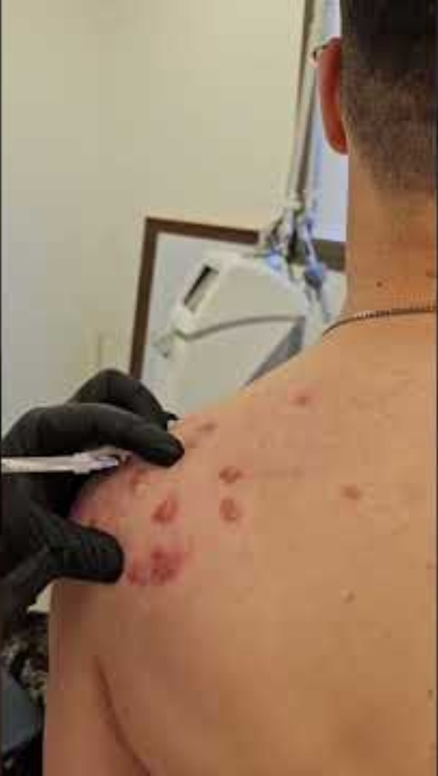
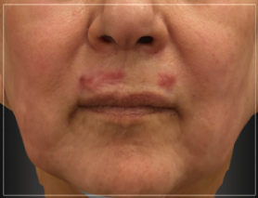
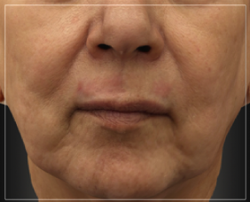
Scar Revision
Hypertrophic Scars and Keloid Scars
Superficial injection
Smaller doses
Lower risk of lipoatrophy
(Click the picture to watch the video)
Before
After
Procedure performed by Dr. Marina Landau, Dermatologist, 5Fu injection
Dr. Alex Levenberg, Plastic Surgeon, corticosteroids injection

Slide 20
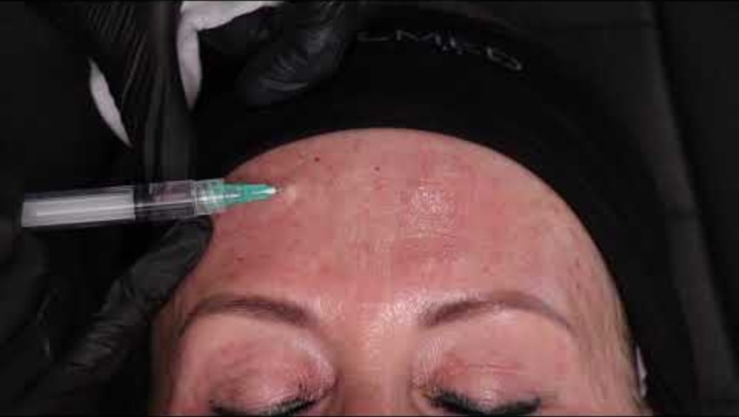
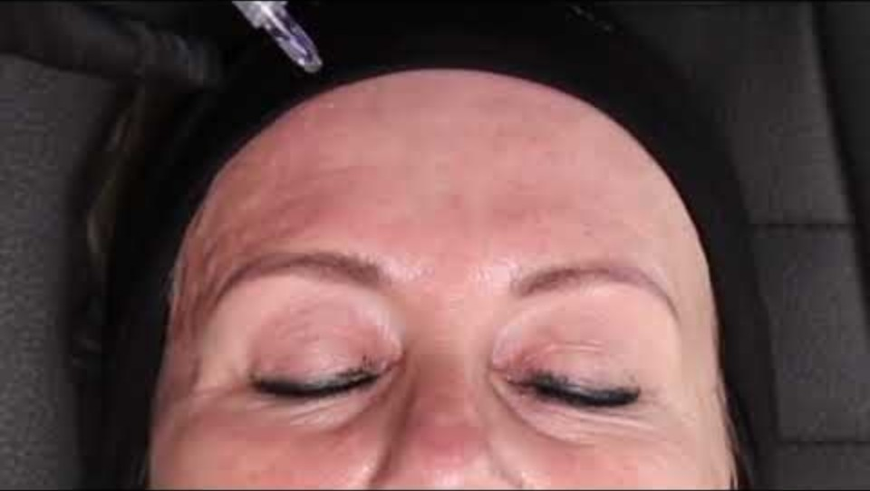
Microtoxin
Hypodermic Needle Vs. MicronJetTM
(Click the picture to watch the video)
Procedures performed by Dr. Riekie Smit, Aesthetic Clinician

Slide 21
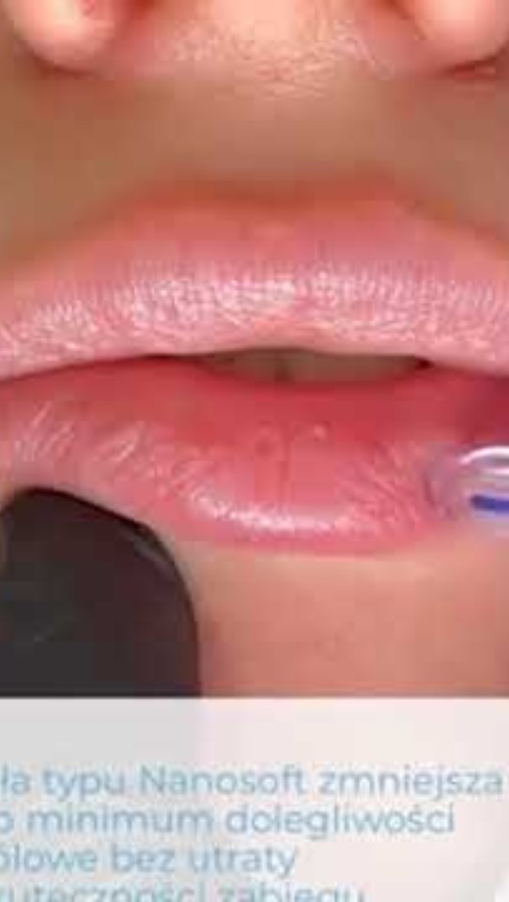
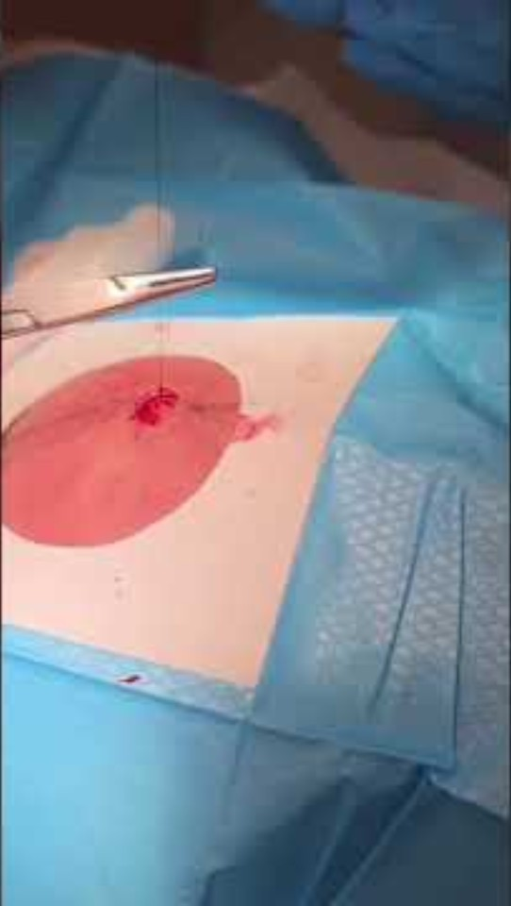
Lips Hydration
Local anesthesia for drainage of pus from a furuncle
(Click the picture to watch the video)
Procedure performed by Dr. Riekie Smit, Aesthetic Clinician
Dr. Alex Levenberg, Plastic Surgeon, Lidocaine

Slide 22
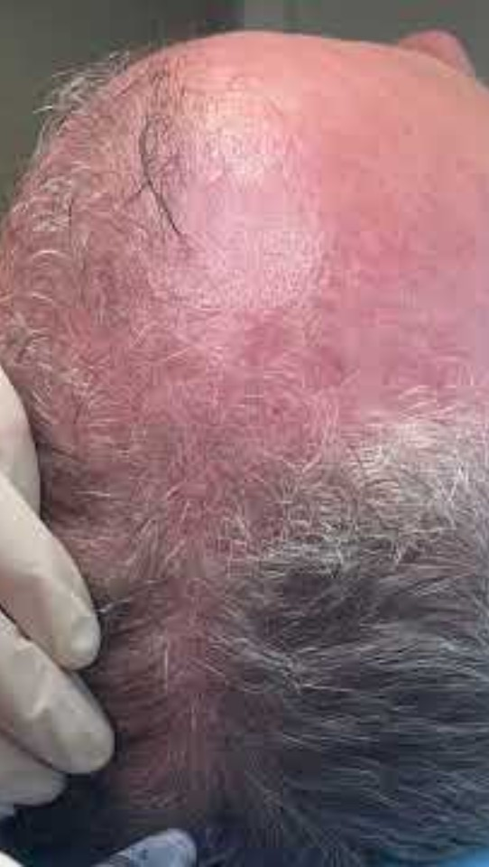
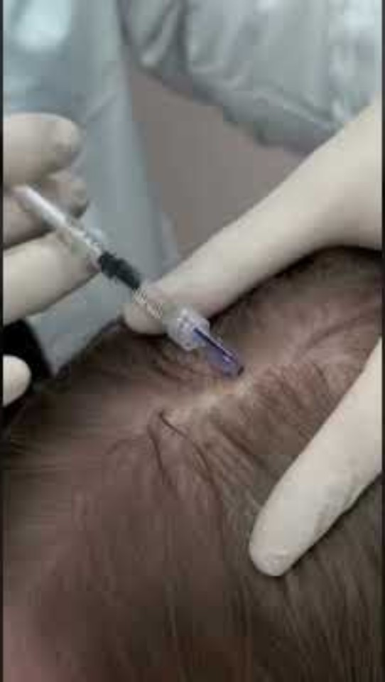
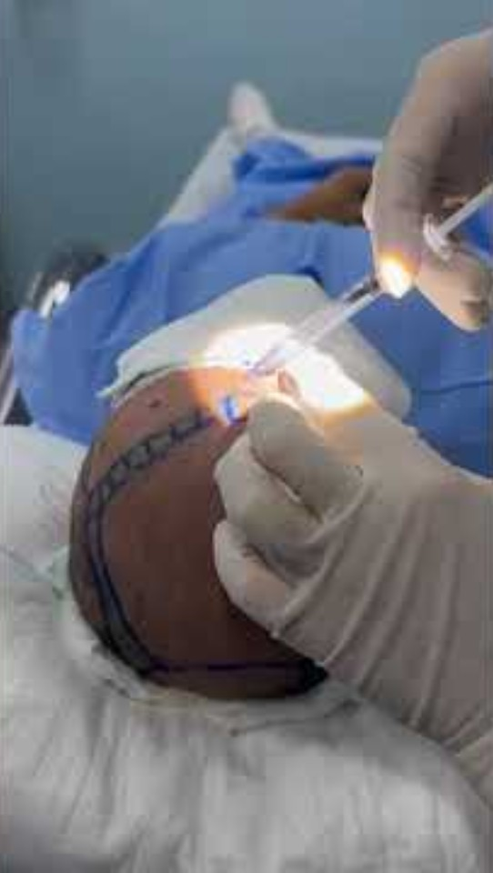
Hair Restoration
Scalp Injections with MicronJetTM 800
(Click the picture to watch the video)
Procedure performed by Dr. Elisabeth Dancey, Cosmetics Clinician
Procedures performed by Dr. Marat Perich, Aesthetics Clinician
Procedure performed by Dr. Francisco Le Voci, Dermatologist

Slide 23
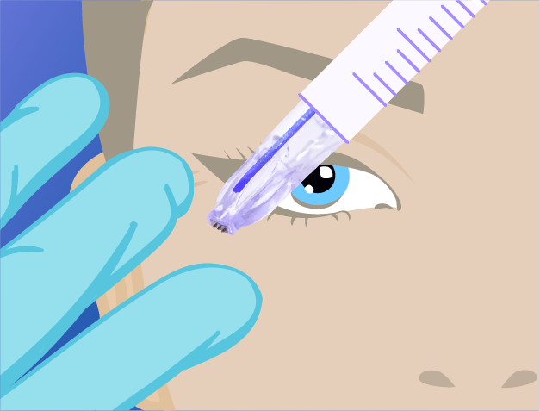

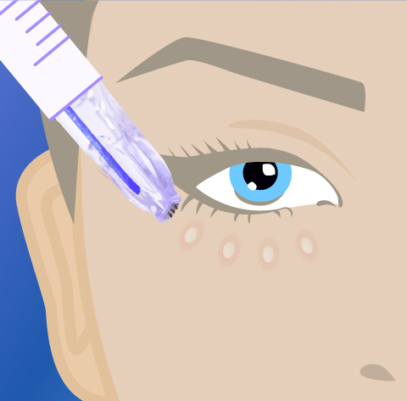
Just Place. Push. Pull
https://www.youtube.com/watch?v=WR5vOScmYKg
Place & Stretch
Push
Pull
Verify the treatment area is dry, stretch the skin and insert the device at a 45-70⁰ angle. Then flatten a bit, with the blue orientation line facing you.
Push the syringe’s plunger and inject slowly. Continue injecting until a bleb forms.
Once the product has been fully delivered, easily pull MicronJetTM out.
Notes:
I wouldn’t simply say flatten, I would say ancor by slightly flattening (like a shovel)
In what distances should people inject?

Slide 24
Good Luck!

